Slide 1



1st
$$φ1$$
2nd
$$φ2$$
$$θ$$

Slide 2
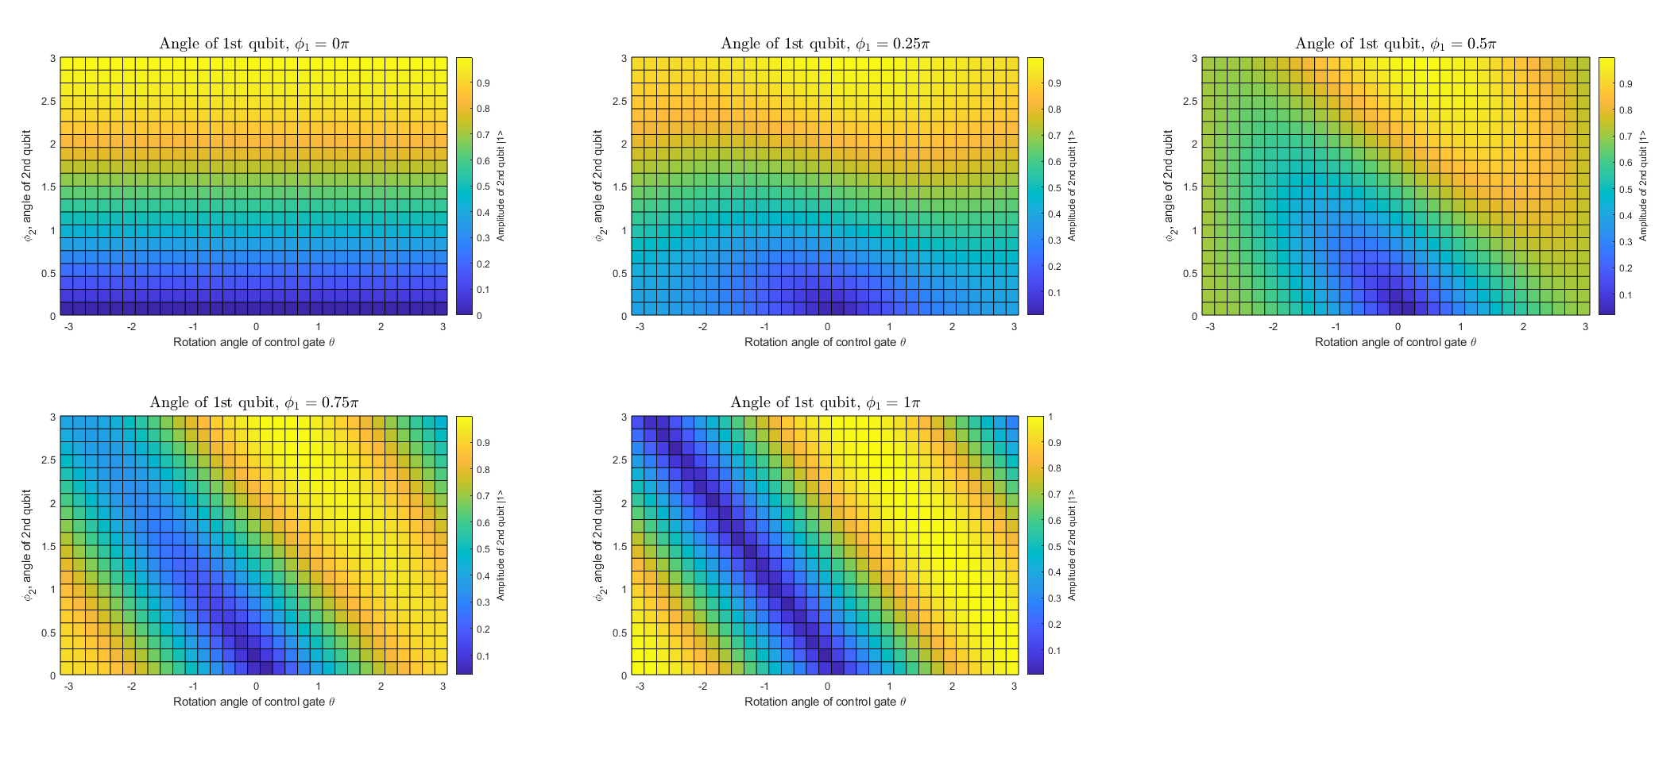

Slide 3



1st
$$φ1$$
2nd
$$φ2$$
$$θ$$

Slide 4
1st
$$φ1$$
2nd
$$φ2$$
$$θ$$

Slide 5
1st
$$φ1$$
2nd
$$φ2$$
$$θ$$

